Slide 1



OPPORTUNITY REVIEW
DIRECT-TO-EMPLOYER GTM STRATEGY
Exploring a Kettering Health Network DTE Plan

Slide 2


Founded in 1979, headquartered in Indianapolis
Largest Independently-Owned Full-Service Third-Party Administrator
Specialize in Administration of Self-Funded Plans and Population Health Management​
Leader in the Direct-to-Employer Movement
We Know and Understand the Market
Experience Working with All Professional Teams: Agents, Networks, MGAs
The Key Family of Companies is a Vertically Integrated group of benefit related organizations
3,000+ Corporate Clients
3 Million Members under Management
700 Employees

Slide 3


MARKET LEADER
IN
PRIVATE LABELED
DTE PLANS
Louisville, KY
OneHealth Plan
Cincinnati, OH
TCH Optimal
Bentonville, AR
Northwest Health Plan
Knoxville, TN
East Tennessee Health Plan
Meridian, MS
Affinity Health Plan
Fort Myers, FL
Lee Health Care Partners

Slide 4







HEALTHCARE PAYERS TAKE POWER
1965
1990s-2000s
2020-present
1929
Medicare and Medicaid established, providing health coverage for the elderly and low-income individuals.
Consolidation of health insurance industry, leading to a few large payers with significant market power.
Healthcare payers are the most powerful players in healthcare, with provider friction at an all-time high.
Blue Cross Blue Shield founded in Texas, providing early health insurance coverage.
Solving Problems
Taking Power
Abusing Power
1940s-1950s
Employer-sponsored health insurance becomes widespread. Providers embrace insurance as the best path to get paid.
1970s-1980s
2010
Rise of managed care organizations (HMOs, PPOs) which negotiate rates with healthcare providers.
Affordable Care Act (ACA) changes payer incentives to dramatically grow healthcare costs.
4

Slide 5
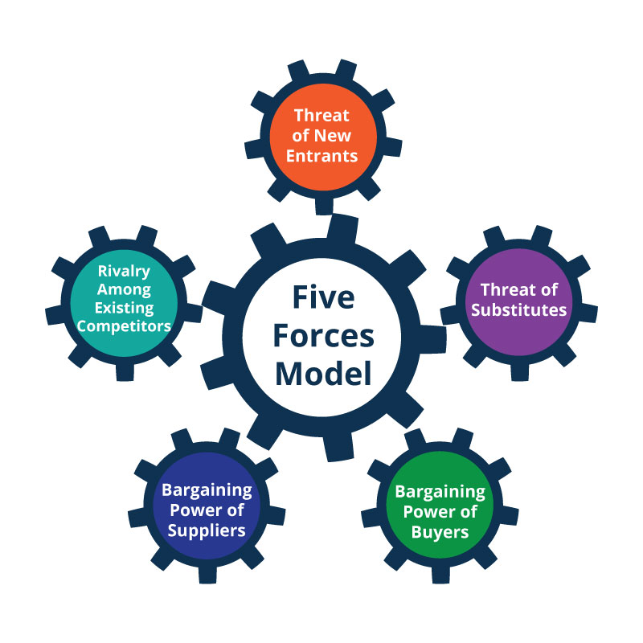

PUTTING A NAME TO THE PROBLEM
CHANNEL DEPENDENCY RISK
EXAMPLES OF CHANNEL DEPENDENCY RISK
Amazon hurts publishing houses
App stores hurt mobile apps
Gig economy platforms hurt gig workers
Netflix hurts film studios
PORTER'S FIVE FORCES
Channel dependency risk is a form of bargaining power of carriers (payers).
5

Slide 6


REBUILDING A DIRECT GO-TO-MARKET STRATEGY
10 HEALTH SYSTEMS IN 10 WEEKS EXPLORE DTE PLAN MODELING
Five-Hospital System in Southwest
2,500+ Bed NE System
State Hospital Association (Led By Largest Health System)
Ten-Hospital Western Health System
Four-Hospital Midwest Health System
Leading Academic Health System
Four-Hospital Eastern Community Health System
Competitor Health System by the Above Health System
1,500+ Bed Health System
Leading Academic Hospital in the Southeast
6

Slide 7


DIRECT-TO-EMPLOYER (DTE)
YOU Pick the Name of the Health Plan
YOU Determine the Fees Charged
YOU Practice the Medicine
YOU Receive the Profits
WE Make it Successful
Your Health Plan Focused on a Direct Relationship with Self-Funded Employers in Your Market

Slide 8

DTE KEYS TO SUCCESS FOR KETTERING HEALTH NETWORK
1
2
DTE Plan Sells
DTE plans only work when the network is built around a strong brand with good access and competitive costs.
Kettering Health Network is the quality and access leader in this service area (see slide 8). Market size and brand quality are likelty to negatively impact plan growth
Estimates for Margin and Steerage Hold
KBA models high, medium and low estimates for net income based on (1) estimates of commercial margin and (2) the within-DTE-network steerage rate.
Profit growth will hold if these assumptions accurately play out as expected for Kettering Health Network.

Slide 9

Direct-to-Employer Strategy: POWERFUL EMPLOYER VALUE
Reduced medical spend through lower unit costs and better integrated care
“At the table” with Kettering Health Network
Aligned financial incentives
Complete transparency for unlimited visibility into health benefit plan expenses and cost drivers
Aggressive stop-loss premiums and policy terms
Increased employee satisfaction
Improved cash flow & stabilization of future medical cost trend

Slide 10







KBA PLAN GROWTH IN THE FIRST TWO YEARS
1,600 Lives
6,400 Lives
1,800 Lives
12,900 Lives
An average of 25 employer groups in plan within the first two years!

Slide 11
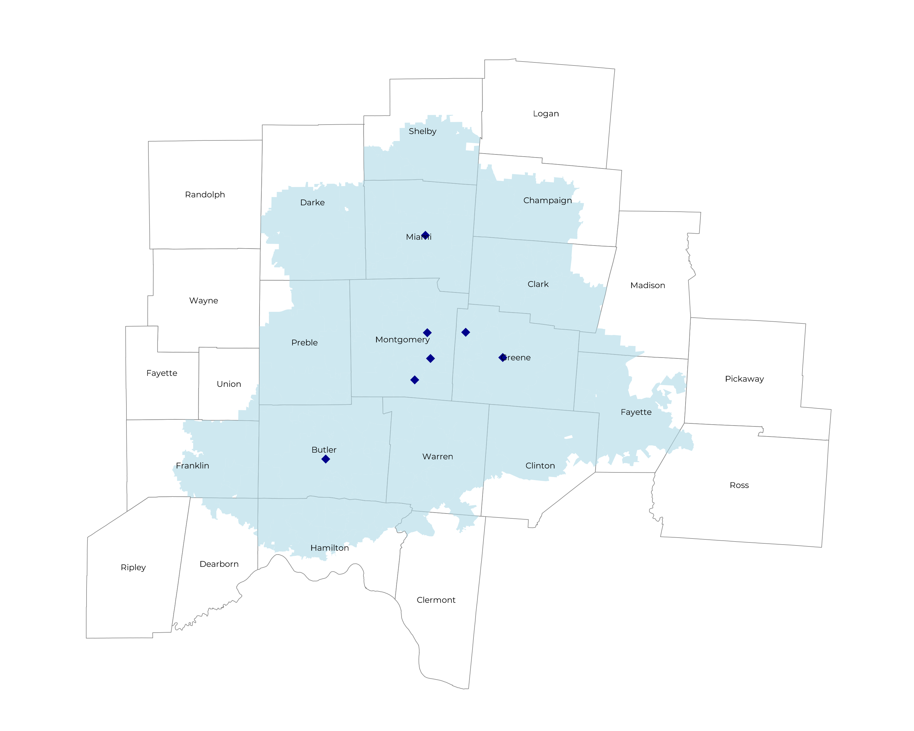
SIGNIFICANT OPPORTUNITY FOR PLAN GROWTH Researched for the below highlighted service area
Target Market 2,800+ Employers 600,000+ Employees 1,000,000+ Members
 | Employer Size Group (# of Employees)
Commercial Employers With Headquarters | 50-100 | 101-200 | 201-400 | 401-1,000 | 1,001-3,000 | 3,000+
In Catchment Area | 1,407 | 669 | 407 | 250 | 72 | 50
Total Employees at Employers | 50-100 | 101-200 | 201-400 | 401-1,000 | 1,001-3,000 | 3,000+
Headquartered in Catchment Area | 105,500 | 100,400 | 122,100 | 175,000 | 144,000 | 300,000
Total Members with Employers | 50-100 | 101-200 | 201-400 | 401-1,000 | 1,001-3,000 | 3,000+
Headquartered in Catchment Area | 189,900 | 180,700 | 219,800 | 315,000 | 259,200 | 540,000

Slide 12
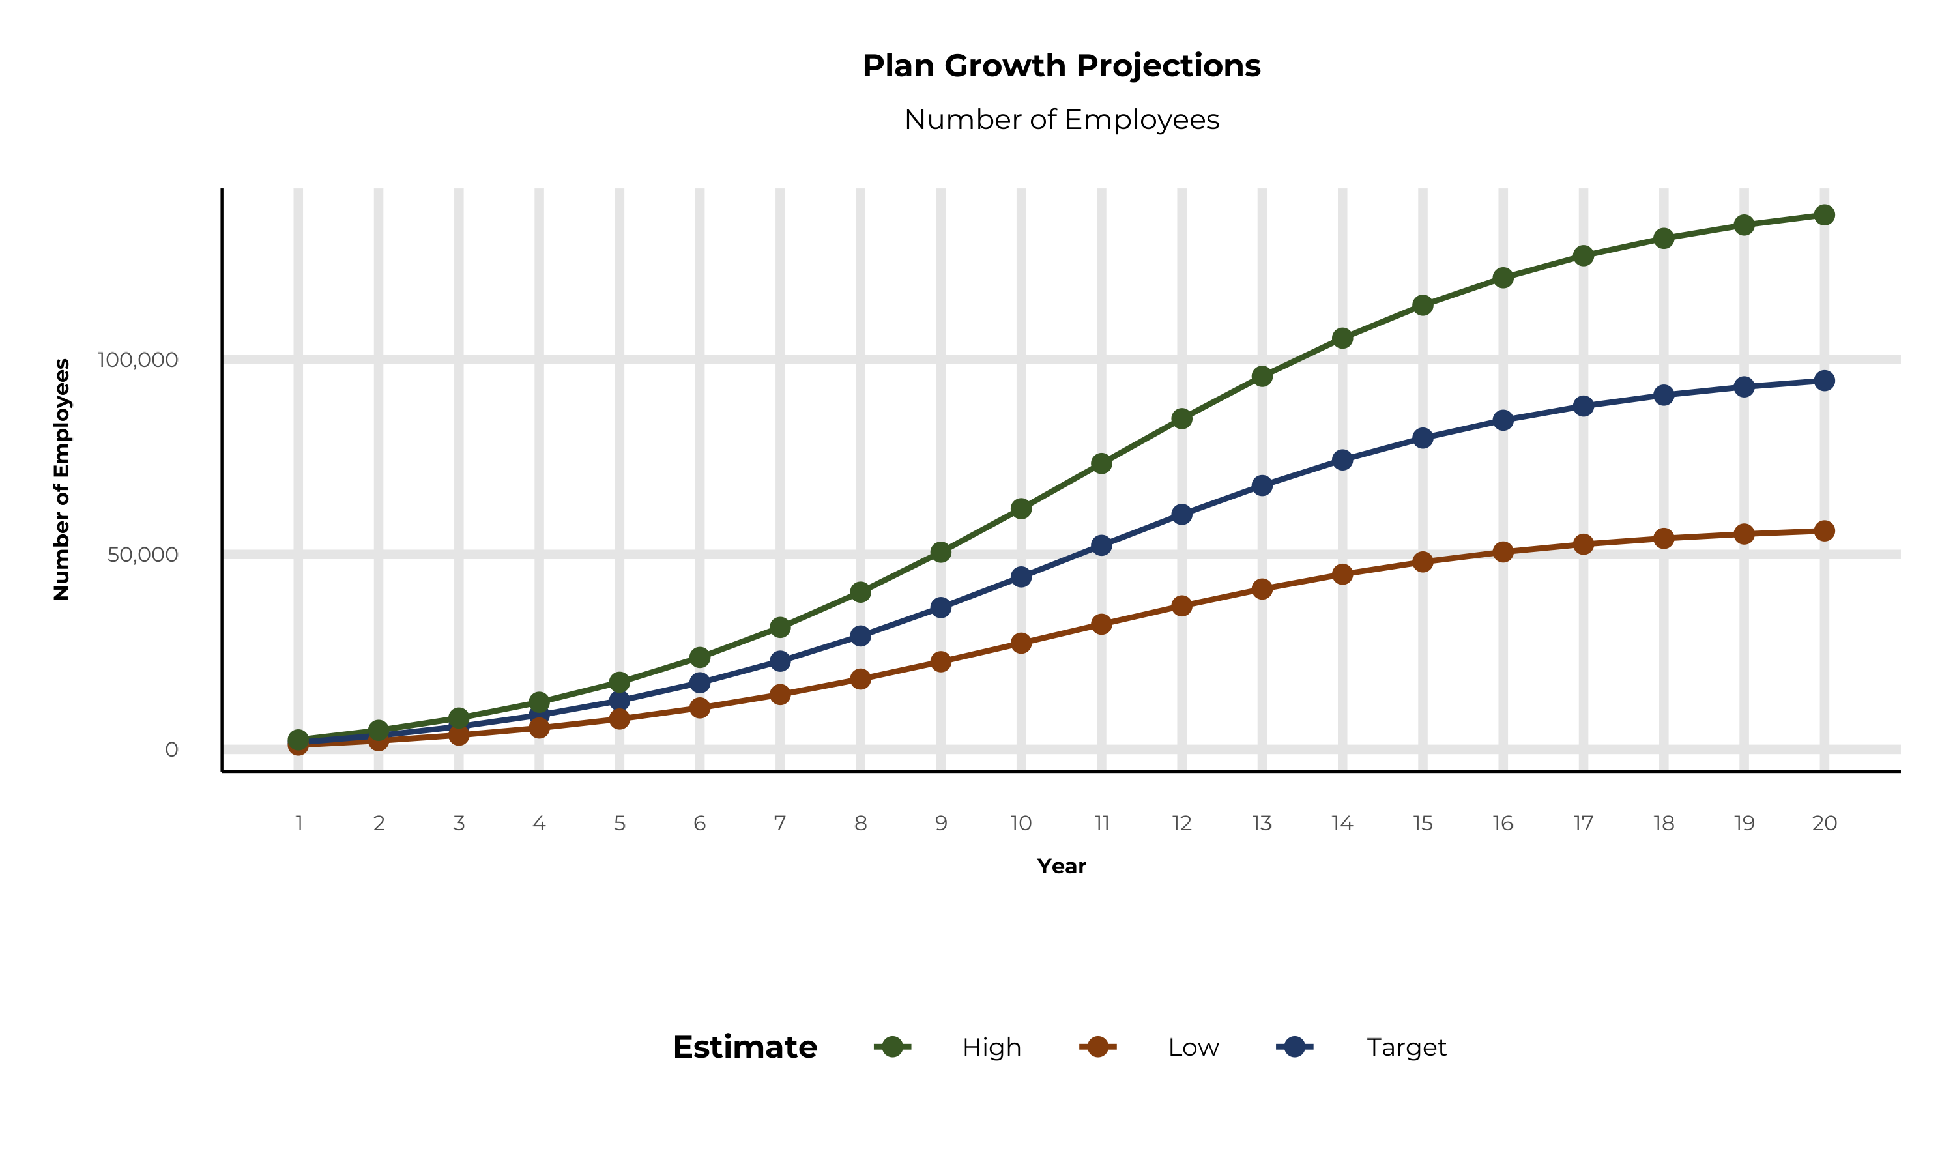
PLAN POTENTIAL GROWTH PATHS
Self Funded
648K
Insured
925K
Working Age
1,296K
Population
2,235K
Estimates includes the Kettering Health Network service area in Dearborn, Franklin, Union, Butler, Champaign, Clark, Clermont, Clinton, Darke, Fayette, Greene, Hamilton, Madison, Miami, Montgomery, Preble, Shelby, and Warren Counties

Slide 13
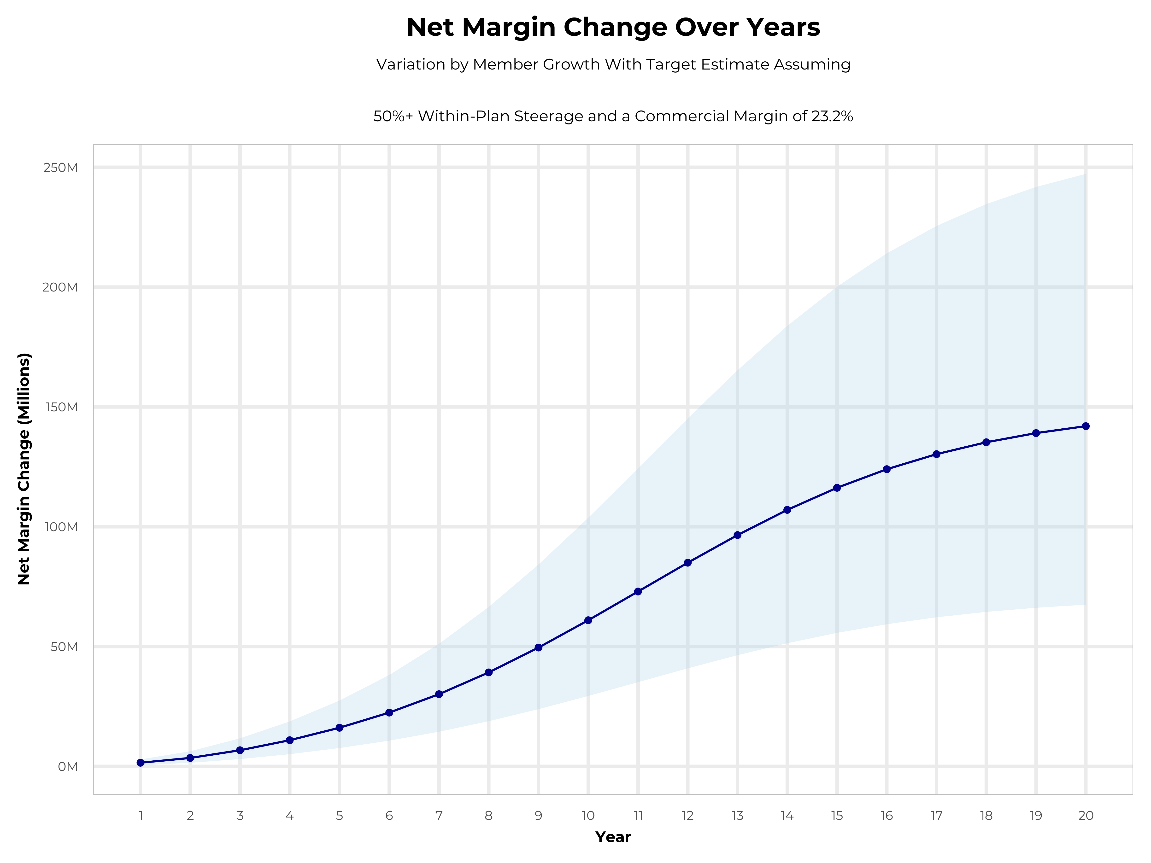
GROWING POWERFUL, LASTING PROFITABILITY
Early Stage
Gaining Name Recognition, Early Growth
New Revenue:
New Profit:
$44.01M
$10.2M
Growth Stage
Strong Reputation, Strong Growth
New Revenue:
New Profit:
$263.62M
$62.05M
Mature Stage
High Profitability, Market Saturation
New Revenue:
New Profit:
$542.26M
$127.7M

Slide 14
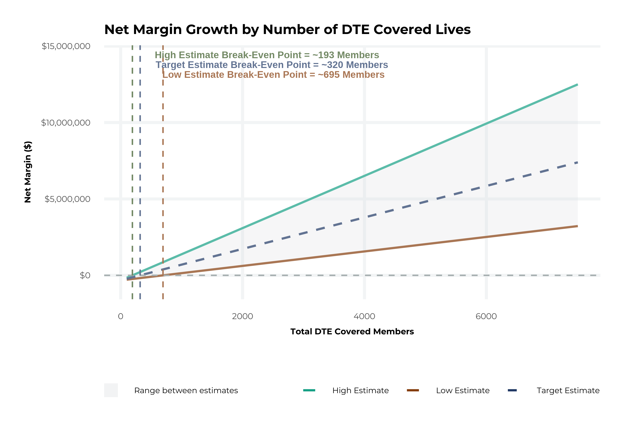
MODEL ASSUMPTIONS AND BREAK EVEN
Patient Steerage Assumptions
KBA currently estimates that Kettering Health Network has 18% inpatient market share, and 17% outpatient market compared to hospitals/clinics in the Kettering Health Network service area (see slide 8). The DTE tiered structure will create immediate steerage, with additional steerage over time from patient bonus benefits and the patient card (see slide 34 for estimates of target steerage).
Low
High
10% below target
10% above target
Commercial Margin Assumptions
KBA observes a Kettering Health Network 29% commercial margin. Conservatively, we model the DTE to be even with commercial rates given prices 10% below market, but with a 10 percentage-point increase through friendlier billing practices and improved patient collections with the patient card.
Low
Target
High
18.2%
23.2%
28.2%

Slide 15
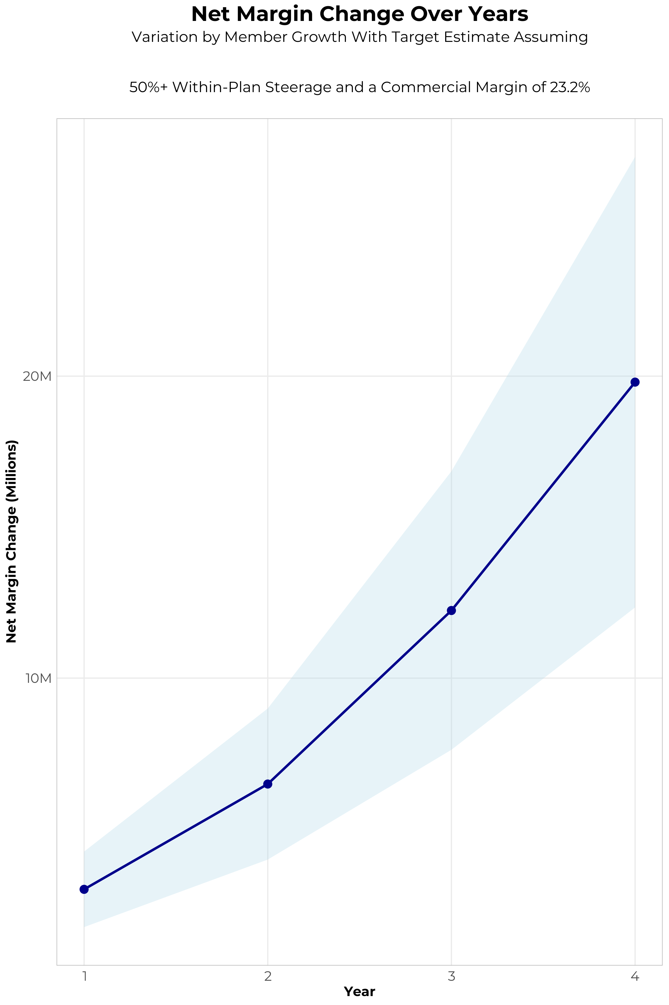
FOUR-YEAR PROJECTIONS
Target Member Growth | Target Member Growth | Target Member Growth | Target Member Growth | Target Member Growth
Metric | Year 1 | Year 2 | Year 3 | Year 4
Number of Members | 3,200 | 6,400 | 10,500 | 15,800
Incremental Margin | 3,296.3K | 6,595.3K | 12,293.1K | 19,793.2K
Network Access Fee | 38.4K | 76.8K | 126.0K | 189.6K
Implementation Fee (One-Time) | -150.0K | 0.0K | 0.0K | 0.0K
Sales and Marketing Costs | -180.0K | -180.0K | -180.0K | -180.0K
Net Margin Change | 3,004.7K | 6,492.1K | 12,239.1K | 19,802.8K
High Member Growth | High Member Growth | High Member Growth | High Member Growth | High Member Growth
Metric | Year 1 | Year 2 | Year 3 | Year 4
Number of Members | 4,400 | 8,800 | 14,400 | 21,700
Incremental Margin | 4,532.4K | 9,068.5K | 16,859.1K | 27,184.3K
Network Access Fee | 52.8K | 105.6K | 172.8K | 260.4K
Implementation Fee (One-Time) | -150.0K | 0.0K | 0.0K | 0.0K
Sales and Marketing Costs | -180.0K | -180.0K | -180.0K | -180.0K
Net Margin Change | 4,255.2K | 8,994.1K | 16,851.9K | 27,264.7K
Low Member Growth | Low Member Growth | Low Member Growth | Low Member Growth | Low Member Growth
Metric | Year 1 | Year 2 | Year 3 | Year 4
Number of Members | 2,000 | 4,000 | 6,600 | 9,900
Incremental Margin | 2,060.2K | 4,122.1K | 7,727.1K | 12,402.1K
Network Access Fee | 24.0K | 48.0K | 79.2K | 118.8K
Implementation Fee (One-Time) | -150.0K | 0.0K | 0.0K | 0.0K
Sales and Marketing Costs | -180.0K | -180.0K | -180.0K | -180.0K
Net Margin Change | 1,754.2K | 3,990.1K | 7,626.3K | 12,340.9K

Slide 16
DIRECT-TO-EMPLOYER STRATEGY: ONLY AVAILABLE TO PREMIER HEALTH SYSTEMS
STRONG Brand Quality
EXTENSIVE Patient Access
AFFORDABLE Value Pricing
EXCELLENT Care Quality

Slide 17
KETTERING HEALTH NETWORK IS PATIENT RECOMMENDED
Health System | HCAHPS Recommendation Percentile | CMS Stars Percentile | Mortality Percentile | Readmission Percentile | KBA Brand Quality Score
Christ Hospital System | 91 | 100 | 68 | 74 | 75
Kettering Health Network | 62 | 74 | 65 | 66 | 66
St Elizabeth Healthcare | 62 | 93 | 79 | 64 | 66
UC Health | 54 | 67 | 63 | 55 | 65
CommonSpirit Health | 55 | 74 | 72 | 69 | 64
Other Independent Hospitals | 39 | 31 | 60 | 82 | 57
Bon Secours Mercy Health | 29 | 74 | 78 | 64 | 54
Premier Health | 23 | 65 | 78 | 51 | 53
Based on quality measures and HCAHPS feedback, KBA estimates that Kettering Health Network has the strongest brand in the Dayton area.

Slide 18
Out of Network
Friends & Family (Contracted)
Wrap Network (Rented)
Kettering Health Network’s Network
The medical providers in your direct control or part of Kettering Health Network’s integrated delivery system
Potential risk sharing arrangements (e.g. employer stop-loss participation)
Friends & Family Providers – TIER 1
Access through direct contracts at the discretion of Kettering Health Network
WRAP NETWORK
Medical services from national PPO networks for members that travel, tertiary and specialty services you do not provide, and employees residing outside your direct catchment area
OUT-OF-NETWORK
Non-contracted medical providers

Slide 19

BENEFIT PLAN DESIGNS THAT OPTIMIZE STEERAGE TO KETTERING HEALTH NETWORK
Exclusive Provider Organization (EPO) Plan Design Structure

Slide 20
SINGLE YEAR SUMMARY
DTE Covered Members Financial Analysis | DTE Covered Members Financial Analysis | DTE Covered Members Financial Analysis | DTE Covered Members Financial Analysis | DTE Covered Members Financial Analysis | DTE Covered Members Financial Analysis | DTE Covered Members Financial Analysis | DTE Covered Members Financial Analysis
Target Estimate Assuming 50%+ Within-Plan Steerage and a Commercial Margin of 23.2%. | Target Estimate Assuming 50%+ Within-Plan Steerage and a Commercial Margin of 23.2%. | Target Estimate Assuming 50%+ Within-Plan Steerage and a Commercial Margin of 23.2%. | Target Estimate Assuming 50%+ Within-Plan Steerage and a Commercial Margin of 23.2%. | Target Estimate Assuming 50%+ Within-Plan Steerage and a Commercial Margin of 23.2%. | Target Estimate Assuming 50%+ Within-Plan Steerage and a Commercial Margin of 23.2%. | Target Estimate Assuming 50%+ Within-Plan Steerage and a Commercial Margin of 23.2%. | Target Estimate Assuming 50%+ Within-Plan Steerage and a Commercial Margin of 23.2%.
DTE Members | Pre-DTE Revenue | Pre-DTE Margin | DTE Revenue | DTE Incr. Revenue | DTE Total Margin | DTE Incr. Margin | Net Margin Less DTE Fees
100 | $ 219K | $ 51K | $ 658K | $ 439K | $ 153K | $ 102K | $ -227K
500 | $ 1,094K | $ 254K | $ 3,288K | $ 2,194K | $ 763K | $ 509K | $ 185K
1,000 | $ 2,188K | $ 508K | $ 6,576K | $ 4,388K | $ 1,526K | $ 1,018K | $ 700K
2,500 | $ 5,470K | $ 1,269K | $ 16,440K | $10,971K | $ 3,814K | $ 2,545K | $ 2,245K
10,000 | $21,879K | $ 5,076K | $ 65,761K | $43,883K | $15,257K | $10,181K | $ 9,971K
20,000 | $43,757K | $10,152K | $131,523K | $87,766K | $30,513K | $20,362K | $20,272K
NOTE: Please see detailed financial analysis and assumptions used starting on page 28.
Financial projections do not include 340B contribution margin, which could represent $136 PMPM by optimizing 340B through Rx plan design, Kettering Health Network’s approved site(s) with network integration, and development of Kettering Health Network’s proprietary PBM program.

Slide 21


INTEGRATION WITH EPIC EHR SYSTEM
KBA shares
evidence-based standards of care for 27 chronic conditions directly into Epic
Hyperthyroidism: Yearly Clinical Evaluation, TSH and T4

Slide 22

THE MISSING PIECE TO VALUE-BASED CARE
Patient engagement is the weak link in delivering value-based care; Kettering Health Network’s clinical leadership and employer participation can drive better outcomes.
KBA’s proactive care-management team supplements your care-management efforts in outreach to clients.
Kettering Health Network excels in Standards of Care completion rates for the Chronically Ill, improving care and costs.
Integrating Kettering Health Network’s managed care with KBA’s programs positions Kettering Health Network as the value leader.

Slide 23

TRANSPARENT PBM INTEGRATION
Support of Kettering Health Network’s retail pharmacy(s)
Optimize Kettering Health Network’s 340B drug
pricing program
Allows Kettering Health Network to create its own PBM program if desired
Custom telephone number with personalized scripting and separate call tracking & reporting
Fully customizable member welcome booklet & materials
White labeled formulary document and marketing materials
CUSTOM CLIENT SUPPORT:
Specialized call center capabilities
Fully customizable plan designs
Operational access to the platform
Customized process and functions to promote DTE strategy
CLINICAL FLEXIBILITY:
Full portfolio of custom formulary offerings – with optimized formulary shield
Clinical programs that drive towards overall DTE strategy
Options for additional drug savings by driving members to lower cost alternatives
Flexibility to customize or layer on utilization management programs

Slide 24
STOP-LOSS INSURANCE THE KBA EXPERIENCE
Tokio Marine
Nationwide
Berkshire Hathaway
Sun Life
Liberty Mutual
Granular (Google)
Companion Life
Crum & Forster
American Fidelity
RGA
Deep relationships with 20+ stop loss underwriters and carriers
Over $150M in annual stop loss premium placement
Comprehensive pricing and medical service analysis performed for each DTE health plan to ensure proper pricing
KBA provides the administration required of the stop-loss markets:
Bordereau Reporting
Claim Reporting and Reconciliation
Evaluation of Networks
Care Management
Initial Underwriting
Negotiation of rates and terms
Plan Design Actuarial

Slide 25

DTE PROGRAM MARKETING & SALES
KBA WORKS WITH YOU TO MANAGE & SELL:
Branding & Messaging
Direct & Brokerage Sales Distribution – Focused Sales Representative
Brochures, Web Site, Media, etc.
Stop-Loss/Level Funded Down to 20 EE Lives
Sell Through Established Brokers in Your Service Area

Slide 26

COMMUNITY BASED SALES STRATEGY
Locally based sales rep with strong community ties
Collaboration with DTE provider partners to identify strategic employers for early adoption and sales
Work with select broker distribution partners with aligned incentives and goals
Pipeline reporting and collaboration with our DTE provider partners
Marketing and promotion of the new option in the community

Slide 27


Complete Marketing System
Customized Branding and Messaging
Customized Brochures
Customized Web Site
Targeted Employer Outreach
Sales System (Social Media, Email, Text, etc.)

Slide 28

THE KBA HEALTHCARE CREDIT CARD
Creating EPO Steerage in a PPO Network
The Healthcare Credit Card is eligible to be used only for specific merchant codes.
To utilize at Specific Healthcare Providers
a. Designated Hospitals
b. Urgent Care Facilities
c. Physicians
d. Eligible Ancillary Providers
Out of Pocket Expenses Qualify
0% Interest Rate
Employee Determines Repayment Schedules
5. To Qualify: Answer One Simple Question
Notes:
Replace with slide 1 of updates provided by Jan, but update design to match the rest of ppt

Slide 29
KEY INCENTIVE PLAN (KIP):
BASE MEDICAL + BONUS BENEFITS = YOUR DEDUCTIBLE CAN SIMPLY VANISH
BENEFIT EXAMPLE |  |  |  |  | CLAIM EXAMPLE
BASE MEDICAL BENEFITS |  | BONUS BENEFITS |  |  | “How Your Deductible Can Vanish”
Deductible |  | Benefits Automatically Included In Your Plan, At NO Additional Cost To You! |  |  | CLAIM EXAMPLE: Heart Attack, with Surgery
Single | $2,500 | Preferred Hospital Stay | 5 Days at $500 / Day |  | OP Radiology/X-Ray | $200
Family | $3,500 | Non-Preferred Hospital Stay | 1 Day at $50 / Day |  | OP Diagnostic Labs | $100
Coinsurance | 80% / 20% | OP Surgery | $700 / 1 Day |  | Preferred Hospital Stay, 5 Days at $500/Day | $2,500
Maximum Out-of-Pocket |  | OP Anesthesia | $250 / 1 Day |  | Critical Illness (Heart Attack Benefit) | $2,000
Single | $3,500 | OP Radiology/X-Ray | $200 / 1 Day |  | Health Screening Benefit (Stress-Test) | $125
Family | $7,000 | OP Diagnostic Labs | $100 / 1 Day |  | Wellness Benefit (Telephonic Coaching) | $125
Chronic Disease Management Regimens of Care, Covered at 100% |  | Health Screening Benefit | $125 / 1 Day |  | TOTAL BONUS BENEFIT PAYABLE | $5,050
Healthcare Specific, Interest Free Credit Card to Cover Out-of-Pocket Costs |  | Wellness Benefit | $125/1 Day |  | Less Your Maximum Out-of-Pocket Cost | ($3,500)
 |  | Critical Illness Benefit* | $2,000 Lump Sum |  | Additional Benefit, Payable Directly to You! | $1,550!
 |  | *Critical Illness Benefits pays for 1st Diagnosis: Heart Attack, Stroke, Internal Cancer
Notes:
Replace with slide 2 of updated ppt provided by Jan, but update to match rest of ppt

Slide 30


THE BENEFIT STEERING THE PATIENT TO Kettering Health Network
What Will this Claim Cost Me?
Kettering Health Network patients will often receive cash, not bills after care episodes!
Notes:
Make necessary changes to match slide 4 of updated ppt provided by Jan

Slide 31

FINANCIAL PROJECTIONS
& ASSUPTIONS

Slide 32
ESTIMATION OF KETTERING HEALTH NETWORK’S 2022 PAYER MIX
Payer Group | Total Inpatient Days | Revenue | Payer Mix
All Kettering Health Network | 286,534 | $2,254,159K | 100%
Medicare | 60,503 | $306,857K | 21%
Medicaid | 12,576 | $235,793K | 4%
Other Government Pay | 0
No-Pay, Charity Care | 16,414 | -$137,996K | 6%
Commercial/Self Pay | 197,041 | $1,710,700K | 69%
Estimating Payer Mix
Medicare, Medicaid, and other government payer mixes are estimated as the percentage of inpatient days for each group divided by total inpatient days.
No-pay and charity care is estimated as the percentage of no-pay/charity care compared to total overall revenue.
Commercial/self pay is assumed to be the rest of the total payer mix share.
Estimating Total Inpatient Days
Total inpatient days for ‘No Pay’ and ‘Commercial’ are estimated to be the payer mix estimates for “No Pay, Charity Care” and “Commercial/Self Pay” multiplied by the total number of inpatient days.
Values in blue are taken from the 2021 Medicare Provider Cost Report (https://data.cms.gov/provider-compliance/cost-report/hospital-provider-cost-report/data)
In other analysis, the outpatient payer mix is assumed to mirror the inpatient payer mix.
Values in yellow are taken from Definitive Healthcare data.
Total Medicare patient revenue is reported by CMS in the Medicare Provider Analysis and Review Report (MedPAR)

Slide 33
ESTIMATION OF MARGIN FOR COMMERCIAL VS. GOVERNMENT PAY
The RAND data for Kettering Health Network estimates commercial insurance reimbursements at 259% of Medicare Rates
Estimating Commercial Margin
(Calculated through counterfactual of assuming all CMS/Government pay was paying at commercial rates)
Estimating Gov-Pay Margin
(Calculated through counterfactual of assuming all commercial pay was paying at Medicare rate)
Commercial Revenue | $1,710,700K
Gov-pay revenue at 259% current rate | $1,403,392K
Total Revenue | $3,114,092K
Total Costs | $2,213,982K
Net Income | $900,111K
 | 29%
Commercial Revenue Divided by 259% | $661,477K
Gov-pay revenue | $542,650K
Total Revenue | $1,204,127K
Total Costs | $2,213,982K
Net Income | $ -1,009,855K
 | -84%

Slide 34
ESTIMATING MARKET SHARE
Hospital Name | Number of Beds | Inpatient Total Charges | Outpatient Total Charges | Inpatient Percent of Market Total | Outpatient Percent of Market Total (Assuming 66% of Physicians Employed by Hospitals)
Kettering Health Greene Memorial | 13 | $ 21,203.9K | $ 181,521.6K | <1% | <1%
Kettering Health Main Campus | 386 | $1,948,407.7K | $1,758,400.0K | 8% | 4%
Kettering Health Hamilton | 138 | $ 399,654.7K | $ 603,682.6K | 2% | 1%
Kettering Health Dayton | 240 | $1,084,310.3K | $2,507,537.8K | 4% | 6%
Kettering Health Miamisburg | 168 | $ 368,041.3K | $ 671,440.2K | 1% | 2%
Soin Medical Center - Kettering Health | 168 | $ 630,891.4K | $ 925,017.9K | 3% | 2%
Kettering Health Troy | 28 | $ 76,152.7K | $ 340,388.7K | <1% | 1%
St Elizabeth Ft Thomas | 106 | $ 201,093.4K | $ 250,593.2K | 1% | 1%
St Elizabeth Covington | 528 | $1,300,947.3K | $1,830,583.9K | 5% | 5%
University of Cincinnati Medical Center | 548 | $2,781,347.5K | $2,434,035.0K | 11% | 6%
Wilson Memorial Hospital | 44 | $ 53,576.8K | $ 254,482.3K | <1% | 1%
The Jewish Hospital - Mercy Health | 170 | $ 896,279.5K | $ 689,126.6K | 4% | 2%
Wayne HealthCare | 43 | $ 26,536.8K | $ 156,561.6K | <1% | <1%
McCullough-Hyde Memorial Hospital | 52 | $ 39,130.3K | $ 116,560.5K | <1% | <1%
Miami Valley Hospital | 1,005 | $3,620,195.4K | $3,123,220.4K | 14% | 8%
Mercy Health - Fairfield Hospital | 204 | $ 785,732.4K | $ 733,039.9K | 3% | 2%
Atrium Medical Center | 244 | $ 563,010.9K | $ 556,450.0K | 2% | 1%
Mercy Health - Springfield Regional Medical Center | 210 | $ 832,425.7K | $ 906,444.4K | 3% | 2%
Good Samaritan Hospital | 361 | $1,775,240.6K | $ 881,786.2K | 7% | 2%
The Christ Hospital | 526 | $1,468,869.1K | $1,814,853.4K | 6% | 4%
Upper Valley Medical Center | 139 | $ 270,844.8K | $ 428,568.7K | 1% | 1%
Clinton Memorial Hospital | 75 | $ 47,379.4K | $ 242,751.3K | <1% | 1%
Bethesda North Hospital | 416 | $1,852,605.6K | $ 648,911.2K | 7% | 2%
Mercy Health - West Hospital | 205 | $ 749,242.5K | $ 771,314.9K | 3% | 2%
UC Health West Chester Hospital | 163 | $ 496,839.2K | $ 965,510.5K | 2% | 2%
Ohio Valley Surgical Hospital (Ohio Valley Medical Center) | 24 | $ 15,143.1K | $ 204,368.2K | <1% | 1%
Mercy Health - Urbana Hospital | 25 | $ 23,111.4K | $ 117,263.8K | <1% | <1%
Adena Fayette Medical Center | 25 | $ 22,676.5K | $ 148,835.6K | <1% | <1%
Cincinnati Childrens Burnet Campus | 751 | $2,255,495.8K | $1,778,922.5K | 9% | 4%
Dayton Childrens Hospital | 181 | $ 384,650.5K | $ 581,094.4K | 2% | 1%
18% Inpatient Market Share
17% Outpatient Market Share
For outpatient market share, it is estimated that only 66% of local physicians are employed by area hospitals (Research from the Physician Advocacy Institute: https://www.physiciansadvocacyinstitute.org/Portals/0/assets/docs/PAI-Research/PAI-Avalere%20Physician%20Employment%20Trends%20Study%202019-2023%20Final.pdf?ver=uGHF46u1GSeZgYXMKFyYvw%3d%3d)

Slide 35
Hospital Metrics | Hospital Metrics | Hospital Metrics | Hospital Metrics | Hospital Metrics | Hospital Metrics | Hospital Metrics | Hospital Metrics
Metric | Kettering Health Greene Memorial | Kettering Health Main Campus | Kettering Health Hamilton | Kettering Health Dayton | Kettering Health Miamisburg | Soin Medical Center - Kettering Health | Kettering Health Troy
Total Inpatient Patient Revenue | $3,711K | $393,578K | $69,540K | $224,452K | $68,824K | $114,191K | $13,860K
Total Outpatient Patient Revenue | $31,766K | $355,197K | $105,041K | $519,060K | $125,559K | $167,428K | $61,951K
Total Medicare Revenue | $3,100K | $121,452K | $21,093K | $88,542K | $23,841K | $41,580K | $7,248K
Estimated Medicaid and Other Government-Pay Revenue | $5,462K | $55,983K | $25,704K | $86,702K | $21,252K | $30,552K | $10,137K
Estimated Commercial Revenue | $26,900K | $571,798K | $127,823K | $567,590K | $149,026K | $209,169K | $58,393K
Total Uncompensated Care | $4,497K | $41,597K | $14,160K | $39,899K | $10,785K | $20,110K | $6,948K
Estimated Inpatient Costs | $4,417K | $387,990K | $71,227K | $215,943K | $67,251K | $112,004K | $13,401K
Estimated Outpatient Costs | $37,815K | $350,154K | $107,589K | $499,381K | $122,689K | $164,222K | $59,898K
Total Operating Expenses | $42,233K | $738,144K | $178,816K | $715,324K | $189,940K | $276,226K | $73,299K
Net Income | $-6,769K | $11,088K | $-4,196K | $27,511K | $4,179K | $5,076K | $2,480K
Estimated Payer Mix Percent Medicare | 24.8% | 20.5% | 23.3% | 19.0% | 18.4% | 26.3% | 29.5%
Estimated Payer Mix Percent Medicaid | 3.1% | 4.8% | 4.3% | 4.6% | 3.9% | 3.6% | 2.0%
Estimated Payer Mix Percent Other Government-Pay | 0.0% | 0.0% | 0.0% | 0.0% | 0.0% | 0.0% | 0.0%
Payer Mix Percent No Pay | 11.2% | 5.3% | 7.5% | 5.1% | 5.3% | 6.7% | 8.4%
Estimated Payer Mix Percent Commercial | 60.9% | 69.4% | 65.0% | 71.3% | 72.4% | 63.4% | 60.1%
Estimated Commercial Profit Margin | 13.9% | 28.4% | 28.1% | 29.9% | 28.5% | 30.2% | 29.1%
1. Most data is taken from the CMS provider cost report | 1. Most data is taken from the CMS provider cost report | 1. Most data is taken from the CMS provider cost report | 1. Most data is taken from the CMS provider cost report | 1. Most data is taken from the CMS provider cost report | 1. Most data is taken from the CMS provider cost report | 1. Most data is taken from the CMS provider cost report | 1. Most data is taken from the CMS provider cost report
2. Medicare costs are taken from the Medicare Provider Analysis and Review (MedPAR) | 2. Medicare costs are taken from the Medicare Provider Analysis and Review (MedPAR) | 2. Medicare costs are taken from the Medicare Provider Analysis and Review (MedPAR) | 2. Medicare costs are taken from the Medicare Provider Analysis and Review (MedPAR) | 2. Medicare costs are taken from the Medicare Provider Analysis and Review (MedPAR) | 2. Medicare costs are taken from the Medicare Provider Analysis and Review (MedPAR) | 2. Medicare costs are taken from the Medicare Provider Analysis and Review (MedPAR) | 2. Medicare costs are taken from the Medicare Provider Analysis and Review (MedPAR)
3. Data with 'Estimated' in the title are derived from other data points. | 3. Data with 'Estimated' in the title are derived from other data points. | 3. Data with 'Estimated' in the title are derived from other data points. | 3. Data with 'Estimated' in the title are derived from other data points. | 3. Data with 'Estimated' in the title are derived from other data points. | 3. Data with 'Estimated' in the title are derived from other data points. | 3. Data with 'Estimated' in the title are derived from other data points. | 3. Data with 'Estimated' in the title are derived from other data points.
4. Market Share estimates based on total patient revenues with area hospitals. Ambulatory market share based on regional estimates of the percentage of local physicians employed by area hospitals. See Physician Advocacy Institute | 4. Market Share estimates based on total patient revenues with area hospitals. Ambulatory market share based on regional estimates of the percentage of local physicians employed by area hospitals. See Physician Advocacy Institute | 4. Market Share estimates based on total patient revenues with area hospitals. Ambulatory market share based on regional estimates of the percentage of local physicians employed by area hospitals. See Physician Advocacy Institute | 4. Market Share estimates based on total patient revenues with area hospitals. Ambulatory market share based on regional estimates of the percentage of local physicians employed by area hospitals. See Physician Advocacy Institute | 4. Market Share estimates based on total patient revenues with area hospitals. Ambulatory market share based on regional estimates of the percentage of local physicians employed by area hospitals. See Physician Advocacy Institute | 4. Market Share estimates based on total patient revenues with area hospitals. Ambulatory market share based on regional estimates of the percentage of local physicians employed by area hospitals. See Physician Advocacy Institute | 4. Market Share estimates based on total patient revenues with area hospitals. Ambulatory market share based on regional estimates of the percentage of local physicians employed by area hospitals. See Physician Advocacy Institute | 4. Market Share estimates based on total patient revenues with area hospitals. Ambulatory market share based on regional estimates of the percentage of local physicians employed by area hospitals. See Physician Advocacy Institute

Slide 36

STEERAGE RATES FOR CURRENT DTE NETWORKS
The average Tier 1 Steerage is 83%.
* Data collected from KBA DTE Networks in Q1 2024

Slide 37
PROJECTED PLAN GROWTH
Year | Employees | Members | Percent of Members Choosing Kettering Health Network for Inpatient Care | Percent of Members Choosing Kettering Health Network for Outpatient Care
1 | 1,800 | 3,200 | 60% | 50%
2 | 3,500 | 6,300 | 60% | 50%
3 | 5,800 | 10,400 | 65% | 55%
4 | 8,800 | 15,800 | 67% | 58%
5 | 12,500 | 22,500 | 68% | 60%
6 | 17,100 | 30,800 | 68% | 60%
7 | 22,600 | 40,700 | 69% | 61%
8 | 29,100 | 52,400 | 69% | 62%
9 | 36,400 | 65,500 | 69% | 62%
10 | 44,200 | 79,600 | 70% | 63%
11 | 52,300 | 94,100 | 70% | 63%
12 | 60,300 | 108,500 | 70% | 64%
13 | 67,700 | 121,900 | 71% | 64%
14 | 74,200 | 133,600 | 71% | 65%
15 | 79,800 | 143,600 | 71% | 66%
16 | 84,400 | 151,900 | 72% | 66%
17 | 88,000 | 158,400 | 72% | 66%
18 | 90,800 | 163,400 | 72% | 67%
19 | 93,000 | 167,400 | 72% | 67%
20 | 94,600 | 170,300 | 72% | 67%
KBA currently estimates that Kettering Health Network has 18% inpatient market share, and 17% outpatient market compared to hospitals/clinics in the Kettering Health Network service area (see slide 8).
Based on previous DTE experience, KBA conservatively expects a significant bump in patient steerage to Kettering Health Network.
Additional steerage will occur from additional steerage patient benefits and the patient card.
High estimates start nearly 10% higher than target with low estimates at 10% lower than target

Slide 38
YEAR 4 PROJECTED REVENUE AND PROFIT
Pre-DTE Cohort of 15,800 Employees | Inpatient | Outpatient | Professional | Total
Revenue† | $ 9,738,516 | $ 16,925,480 | $ 7,904,055 | $ 34,568,051
Net Income‡ | $ 2,259,336 | $ 3,926,711 | $ 1,833,741 | $ 8,019,788
† Assuming proportional revenues from market shares of 18% (inpatient) and 17% (outpatient)
‡ Conservatively assuming a commercial margin of 23.2% (80% of the estimated commercial margin)
With DTE | Inpatient | Outpatient | Professional | Total
Revenue⁰ | $ 36,078,632 | $ 56,569,949 | $ 26,417,685 | $ 119,066,267
Net Income* | $ 8,370,243 | $ 13,124,228 | $ 6,128,903 | $ 27,623,374
⁰ Assuming 67% inpatient and 58% market steerage based on KBA narrow network DTE experience (see previous slide)
* Conservatively assuming a commercial margin of 23.2%, with a 10 percentage-point reduction to reflect competitive-edge rates and a 10 percentage-point increase due to lower billing costs and higher patient responsibility collections because of the member credit card.
Total Increase in Net Income | $ 19,603,586
Network Access Fee (Revenue) of $1 PMPM | $ 189,600
Total Profit Growth | $ 19,608,386
Minus Implementation Fee (One-Time) | -$ 0
Minus Sales and Marketing (Annual – Ongoing) | -$ 180,000
Total | $ 19,613,186

Slide 39
Target Estimate Assuming 50%+ Within-Plan Steerage and a Commercial Margin of 23.2% | Target Estimate Assuming 50%+ Within-Plan Steerage and a Commercial Margin of 23.2% | Target Estimate Assuming 50%+ Within-Plan Steerage and a Commercial Margin of 23.2% | Target Estimate Assuming 50%+ Within-Plan Steerage and a Commercial Margin of 23.2% | Target Estimate Assuming 50%+ Within-Plan Steerage and a Commercial Margin of 23.2%
All values in thousands of dollars. Modeled With Year 1 Fees and Patient Steerage. | All values in thousands of dollars. Modeled With Year 1 Fees and Patient Steerage. | All values in thousands of dollars. Modeled With Year 1 Fees and Patient Steerage. | All values in thousands of dollars. Modeled With Year 1 Fees and Patient Steerage. | All values in thousands of dollars. Modeled With Year 1 Fees and Patient Steerage.
Metric | 500 DTE Covered Lives | 1000 DTE Covered Lives | 5000 DTE Covered Lives | 25000 DTE Covered Lives
Pre-DTE Group Inpatient Revenue | $308.2 | $616.4 | $3,081.8 | $15,409.0
Pre-DTE Group Inpatient Margin | $71.5 | $143.0 | $715.0 | $3,574.9
DTE Group Inpatient Revenue | $1,020.2 | $2,040.4 | $10,202.1 | $51,010.5
DTE Group Inpatient Margin | $236.7 | $473.4 | $2,366.9 | $11,834.4
DTE Group Incremental Inpatient Revenue | $712.0 | $1,424.1 | $7,120.3 | $35,601.5
DTE Group Incremental Inpatient Margin | $165.2 | $330.4 | $1,651.9 | $8,259.5
Pre-DTE Group Outpatient Revenue | $535.6 | $1,071.2 | $5,356.2 | $26,780.8
Pre-DTE Group Outpatient Margin | $124.3 | $248.5 | $1,242.6 | $6,213.2
DTE Group Outpatient Revenue | $1,545.9 | $3,091.9 | $15,459.3 | $77,296.4
DTE Group Outpatient Margin | $358.7 | $717.3 | $3,586.6 | $17,932.8
DTE Group Incremental Outpatient Revenue | $1,010.3 | $2,020.6 | $10,103.1 | $50,515.6
DTE Group Incremental Outpatient Margin | $234.4 | $468.8 | $2,343.9 | $11,719.6
Pre-DTE Group Professional Revenue | $250.1 | $500.3 | $2,501.3 | $12,506.4
Pre-DTE Group Professional Margin | $58.0 | $116.1 | $580.3 | $2,901.5
DTE Group Professional Revenue | $721.9 | $1,443.9 | $7,219.4 | $36,096.8
DTE Group Professional Margin | $167.5 | $335.0 | $1,674.9 | $8,374.4
DTE Group Incremental Professional Revenue | $471.8 | $943.6 | $4,718.1 | $23,590.3
DTE Group Incremental Professional Margin | $109.5 | $218.9 | $1,094.6 | $5,473.0
Net Margin Less DTE Fees | $185.0 | $700.1 | $4,820.4 | $25,422.1

Slide 40
Target Estimate Assuming 50%+ Within-Plan Steerage and a Commercial Margin of 23.2% | Target Estimate Assuming 50%+ Within-Plan Steerage and a Commercial Margin of 23.2% | Target Estimate Assuming 50%+ Within-Plan Steerage and a Commercial Margin of 23.2% | Target Estimate Assuming 50%+ Within-Plan Steerage and a Commercial Margin of 23.2% | Target Estimate Assuming 50%+ Within-Plan Steerage and a Commercial Margin of 23.2%
All values in thousands of dollars. Modeled With Year 1 Fees and Patient Steerage. | All values in thousands of dollars. Modeled With Year 1 Fees and Patient Steerage. | All values in thousands of dollars. Modeled With Year 1 Fees and Patient Steerage. | All values in thousands of dollars. Modeled With Year 1 Fees and Patient Steerage. | All values in thousands of dollars. Modeled With Year 1 Fees and Patient Steerage.
Metric | 500 DTE Covered Lives | 1000 DTE Covered Lives | 5000 DTE Covered Lives | 25000 DTE Covered Lives
Pre-DTE Group Total Revenue | $1,093.9 | $2,187.9 | $10,939.3 | $54,696.3
Pre-DTE Group Total Margin | $253.8 | $507.6 | $2,537.9 | $12,689.5
DTE Group Total Revenue | $3,288.1 | $6,576.1 | $32,880.7 | $164,403.6
DTE Group Incremental Total Revenue | $2,194.1 | $4,388.3 | $21,941.5 | $109,707.3
Incremental Total Revenue by Member | $4.4 | $4.4 | $4.4 | $4.4
DTE Group Total Margin | $762.8 | $1,525.7 | $7,628.3 | $38,141.6
DTE Group Incremental Total Margin | $509.0 | $1,018.1 | $5,090.4 | $25,452.1
Wellness Share | $6.0 | $12.0 | $60.0 | $300.0
Implementation Fee (One-Time) | $150.0 | $150.0 | $150.0 | $150.0
Sales and Marketing Annual Fee | $180.0 | $180.0 | $180.0 | $180.0
Net Margin Less DTE Fees | $185.0 | $700.1 | $4,820.4 | $25,422.1

Slide 41
High Estimate Assuming 60%+ Within-Plan Steerage and a Commercial Margin of 28.2% | High Estimate Assuming 60%+ Within-Plan Steerage and a Commercial Margin of 28.2% | High Estimate Assuming 60%+ Within-Plan Steerage and a Commercial Margin of 28.2% | High Estimate Assuming 60%+ Within-Plan Steerage and a Commercial Margin of 28.2% | High Estimate Assuming 60%+ Within-Plan Steerage and a Commercial Margin of 28.2%
All values in thousands of dollars. Modeled With Year 1 Fees and Patient Steerage. | All values in thousands of dollars. Modeled With Year 1 Fees and Patient Steerage. | All values in thousands of dollars. Modeled With Year 1 Fees and Patient Steerage. | All values in thousands of dollars. Modeled With Year 1 Fees and Patient Steerage. | All values in thousands of dollars. Modeled With Year 1 Fees and Patient Steerage.
Metric | 500 DTE Covered Lives | 1000 DTE Covered Lives | 5000 DTE Covered Lives | 25000 DTE Covered Lives
Pre-DTE Group Total Revenue | $1,093.9 | $2,187.9 | $10,939.3 | $54,696.3
Pre-DTE Group Total Margin | $253.8 | $507.6 | $2,537.9 | $12,689.5
DTE Group Total Revenue | $3,911.6 | $7,823.2 | $39,115.8 | $195,578.9
DTE Group Incremental Total Revenue | $2,817.7 | $5,635.3 | $28,176.5 | $140,882.6
DTE Group Total Margin | $1,103.1 | $2,206.1 | $11,030.7 | $55,153.3
DTE Group Incremental Total Margin | $849.3 | $1,698.5 | $8,492.7 | $42,463.7
Wellness Share | $6.0 | $12.0 | $60.0 | $300.0
Implementation Fee (One-Time) | $150.0 | $150.0 | $150.0 | $150.0
Sales and Marketing Annual Fee | $180.0 | $180.0 | $180.0 | $180.0
Net Margin Less DTE Fees | $525.3 | $1,380.5 | $8,222.7 | $42,433.7

Slide 42
Low Estimate Assuming 40%+ Within-Plan Steerage and a Commercial Margin of 18.2% | Low Estimate Assuming 40%+ Within-Plan Steerage and a Commercial Margin of 18.2% | Low Estimate Assuming 40%+ Within-Plan Steerage and a Commercial Margin of 18.2% | Low Estimate Assuming 40%+ Within-Plan Steerage and a Commercial Margin of 18.2% | Low Estimate Assuming 40%+ Within-Plan Steerage and a Commercial Margin of 18.2%
All values in thousands of dollars. Modeled With Year 1 Fees and Patient Steerage. | All values in thousands of dollars. Modeled With Year 1 Fees and Patient Steerage. | All values in thousands of dollars. Modeled With Year 1 Fees and Patient Steerage. | All values in thousands of dollars. Modeled With Year 1 Fees and Patient Steerage. | All values in thousands of dollars. Modeled With Year 1 Fees and Patient Steerage.
Metric | 500 DTE Covered Lives | 1000 DTE Covered Lives | 5000 DTE Covered Lives | 25000 DTE Covered Lives
Pre-DTE Group Total Revenue | $1,093.9 | $2,187.9 | $10,939.3 | $54,696.3
Pre-DTE Group Total Margin | $253.8 | $507.6 | $2,537.9 | $12,689.5
DTE Group Total Revenue | $2,663.0 | $5,326.1 | $26,630.4 | $133,151.9
DTE Group Incremental Total Revenue | $1,569.1 | $3,138.2 | $15,691.1 | $78,455.7
DTE Group Total Margin | $484.7 | $969.3 | $4,846.7 | $24,233.7
DTE Group Incremental Total Margin | $230.9 | $461.8 | $2,308.8 | $11,544.1
Wellness Share | $6.0 | $12.0 | $60.0 | $300.0
Implementation Fee (One-Time) | $150.0 | $150.0 | $150.0 | $150.0
Sales and Marketing Annual Fee | $180.0 | $180.0 | $180.0 | $180.0
Net Margin Less DTE Fees | $-93.1 | $143.8 | $2,038.8 | $11,514.1

Slide 43




COLLABORATION OF STAKEHOLDERS
Key Benefit Administrators
Employer
Employee
Full TPA Administration
Stop-Loss Administration
True Transparency & Analytics
Population Health Management
Utilization & Case Management
Sales & Marketing
Transparent PBM
Website & Mobile App
Customizable options & plans
Incremental Revenues and Margin
Branding & Messaging
Benefit Plan Integration
Network Steerage
Direct Relationship with Self-Funded Employers
Referral Authorization
Plan Transparency
Direct Access to Members
Reduced Out of Pocket
Improved Health
Better Coordination & Navigation of Care
Direct Access to the Best Medical Providers
Kettering Health Network’s DTE
Reduced Spend
“At The Table” with Kettering Health Network
Improved Analytics
Complete Transparency
Lower Stop-Loss
Benefit Plan Stabilization
Healthier Population

Slide 44
ROLES & RESPONSIBILITIES
SERVICES & ADMINISTRATIVE SYSTEMS PROVIDED BY:
Kettering Health Network | KBA Operations
Tier 1 Provider Network Provider Recruitment – If Necessary Network Pricing & Contract Terms Referral Management Protocols & Approvals Medical Director Oversight Practice Improvement Program using KBA/AHDI Data with Assistance from KBA | Network Evaluation – Actuarial Pricing PPO Wrap & Tertiary Transplant Network, if needed Claims Administration Plan Design Development, Testing, and Administration Employer/Member/Provider Customer Service Customized Member/Provider/Agent/HR Portal Billing, Enrollment (Electronic/Paper), and Premium Management Fulfilment – SPD & Customized ID Cards COBRA/HIPAA Administration Out of Network Negotiations Wrap PPO Repricing Nurse Coaching for Chronically Ill Nurse Triage to Physicians and Facilities Stop-Loss Underwriting, Pricing, and Placement Stop Loss Claims Administration Complex Case Management PBM Administration Interface Reporting Utilization & Gaps in Care Clinically Based Physician Profiling Referrals Chronic Disease Management Employer Health Risk Management Reports Ancillary Administration – Dental, Vision, Weekly Income, 5500, Life, etc. Health Savings Account (HSA), Flexible Spending (FSA), Health Reimbursement Account (HRA) Administration Sales & Marketing Plan Strategy Development: Branding, Brochures, Web Site Distribution System Development Sales Management
KBA Consulting
Program oversight and integration across the enterprise Goal development, agreement and tracking Start-up assessments: market, network, operational and readiness Draft business plan with financial projections Facilitate program communication and engagement with Kettering Health Network departments including system c-suite, operations, HR, managed care, marketing, strategy and business development

Slide 45

PRE-IMPLEMENTATION
PROVIDER FILE
PRICING
Determine Gaps in Medical Service Delivery
Identify Other Key Providers to Potentially Contract with on Behalf of Kettering Health Network
Wrap Network to Cover All Other Provider Types
To Dial in Competitive Stop-Loss Rates and Kettering Health Network’s Net Revenues/Margins
Actuarial Evaluation Compared to the Market

Slide 46
IMPLEMENTATION
MONTH 1
Agreement & Project Scope
MONTH 1-6
Implementation
Market Outreach begins in Month 3
MONTH 3-6
Sales & Mkg.
Hire Sales Executive
MONTH 6 TO 8
GO LIVE!!

Slide 47





A PARTNER YOU CAN TRUST
OUR OBJECTIVES ARE ALIGNED
WE KNOW THE
MARKET
COMPLETELY TRANSPARENT
WE HAVE THE SOPHISTICATION AND INFRASTRUCTURE TO EFFECTIVELY COMPETE
Derek Moore, Senior Vice President – KBA
845-283-9973 * derek.moore@keybenefit.com

